Slide 1

Online Movie Ticket Booking
NAME: V SARAH PHILOMIN
REGNO: 38120077 – IT
INTERNAL GUIDE: E.BRUMANCIA M.E., Ph.D.

Slide 2
INTRODUCTION
Welcome to newly designed website,” Online Movie Ticket Booking” is a faster, cleaner and a tad more personal website, specially designed to make your booking experience better.
Customers may view the contents of any available movie/show and may book movie ticket as needed. The program automatically calculates the subtotal and grand total along with the taxes.
The aim is to automate its existing manual system by the help of computerized equipment and full-fledged computer software, fulfilling their requirements, so that their valuable data/information can be stored for a longer period with easy accessing and manipulation of the same.

Slide 3
INTRODUCTION
Basically the project describes how to manage for good performance and better services for the clients.
It may help collecting perfect management in details. In a very short time, the collection will be obvious, simple and sensible. It will help a person to know the management of passed year perfectly and vividly.
It also helps in current all works relative to Movie Ticket Booking System. It will be also reduced the cost of collecting the management & collection procedure will go on smoothly.
Our project aims at Business process automation, i.e. we have tried to computerize various processes of Movie Ticket Booking Portal.

Slide 4
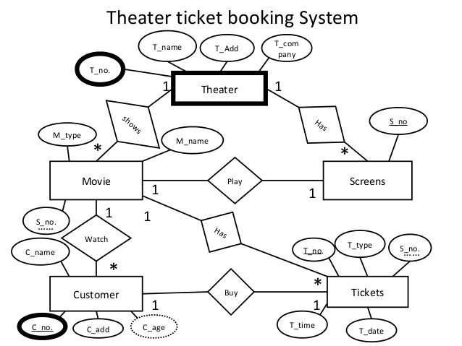
ER DIAGRAM

Slide 5
METHODOLOGY
PROGRAMMING LANGUAGES
HTML-HYPERTEXT MARKUP LANGUAGE
CSS-CASCADING STYLE SHEETS
PHP-HYPERTEXT PREPROCESSOR
SOFTWARE SPECIFICATION
Platform-Windows 10.1
Front End- HTML, CSS
Backend- XAMPP

Slide 6
Programming languages
FRONT END:
HTML:
Hypertext Markup Language (HTML) is the standard markup language for creating webpages and applications. Each page contains a series of connections to other pages called hyperlinks.
HTML describes the structure of a webpage semantically and originally included cues for the appearance of the document.HTML elements are delineated by tags, written using angle brackets.
Browsers do not display the HTML tags, but use them to interpret the content of the page.
HTML code ensures the proper formatting of text and images so that your Internet browser may display them as they are intended to look.
Without HTML a browser would not know how to display text as elements or load images or other elements.
HTML also provides a basic structure of the page, upon which Cascading Style Sheets are overlaid to change its appearance.

Slide 7
Programming languages
CSS:
Cascading Style Sheets (CSS) is a style sheet language used for describing the presentation of a document written in a markup language, CSS is designed primarily to enable the separation of presentation and content including aspects such as the layouts, colors, and fonts.
This separation can improve content accessibility, provide more flexibility and control in the specification of presentation characteristics.
Enables multiple HTML pages to share formatting by specifying the relevant CSS in a separate .css file, and reduce complexity and repetition in the structural content.

Slide 8
Programming languages
PHP:
PHP (Hypertext Preprocessor) is a widely used open source general purpose scripting language that is especially suites for web development and can be embedded into html basically, a server-side scripting language designed primarily for web development but also used a general-purpose programming language.
PHP code may be embedded into HTML or HTML5 markup, or it can be used in combination with various web template systems, web content management systems and web frameworks.
PHP code is usually processed by a PHP interpreter implemented as a module in the web server or as a Common Gateway Interface (CGI) executable.
The web server software combines the results of the interpreted and executed PHP code, which may be any type of data, including images, with the generated webpage code may also be executed with a command-line interface (CLI) and can be used to implement standalone graphical applications.

Slide 9
SOFTWARE REQUIREMENT SPECIFICATION
The Software Requirements is produced at the culmination of the analysis task.
The function and performance allocated to software as part of system engineering are refined by establishing a complete information description.
A detailed functional and behavioral description, an indication of performance requirements and design constraints, appropriate validation criteria, and other data pertinent to requirements.

Slide 10
SOFTWARE REQUIREMENT
Server:
Processor-10th generation i7
RAM-128MB (min)
Hard disk-20GB
Client:
Processor-10th generation i7
RAM-128MB (min)
Hard disk-20GB
Software required:
Platform-Windows 10.1
Front End- HTML, CSS
Backend- XAMPP

Slide 11
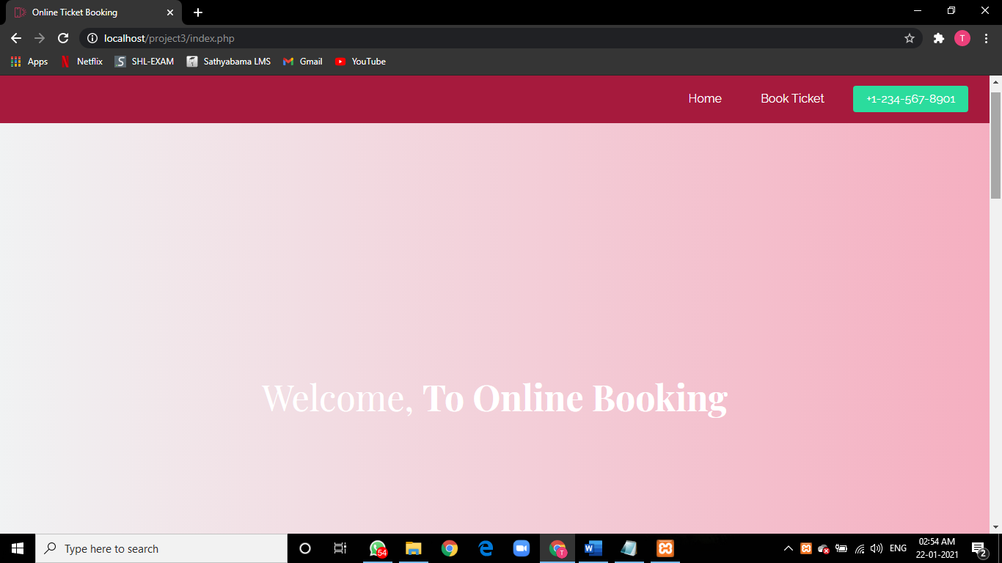
ONLINE- MOVIE TICKET BOOKING PORTAL
INDEX.PHP

Slide 12
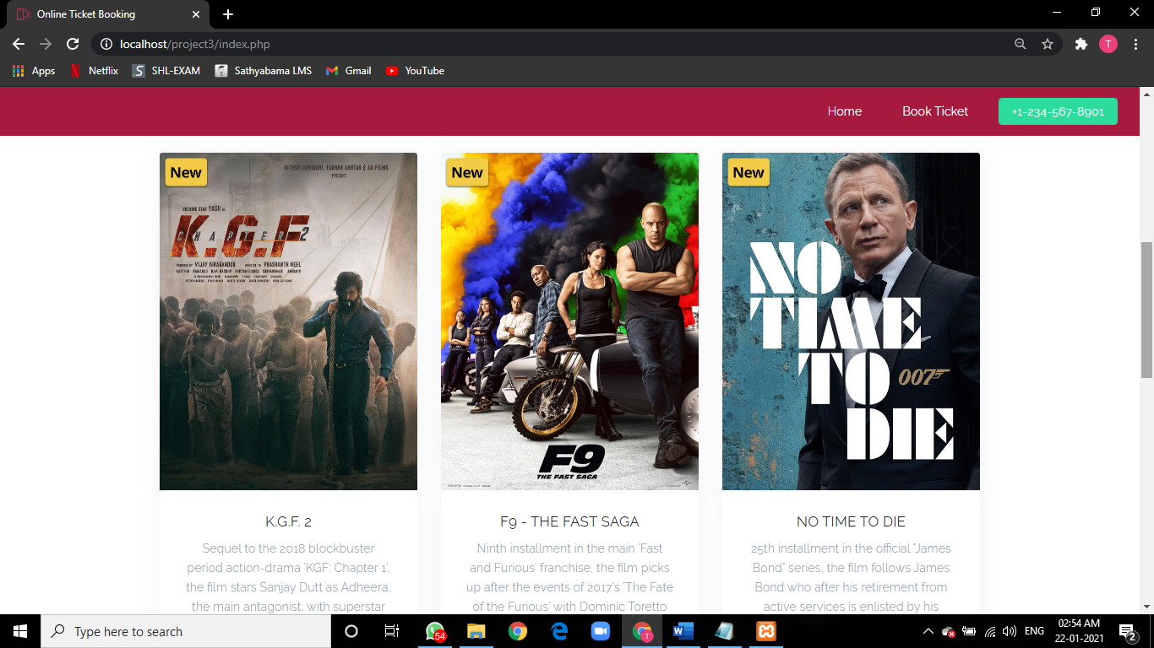
ONLINE- MOVIE TICKET BOOKING PORTAL
INDEX.PHP

Slide 13
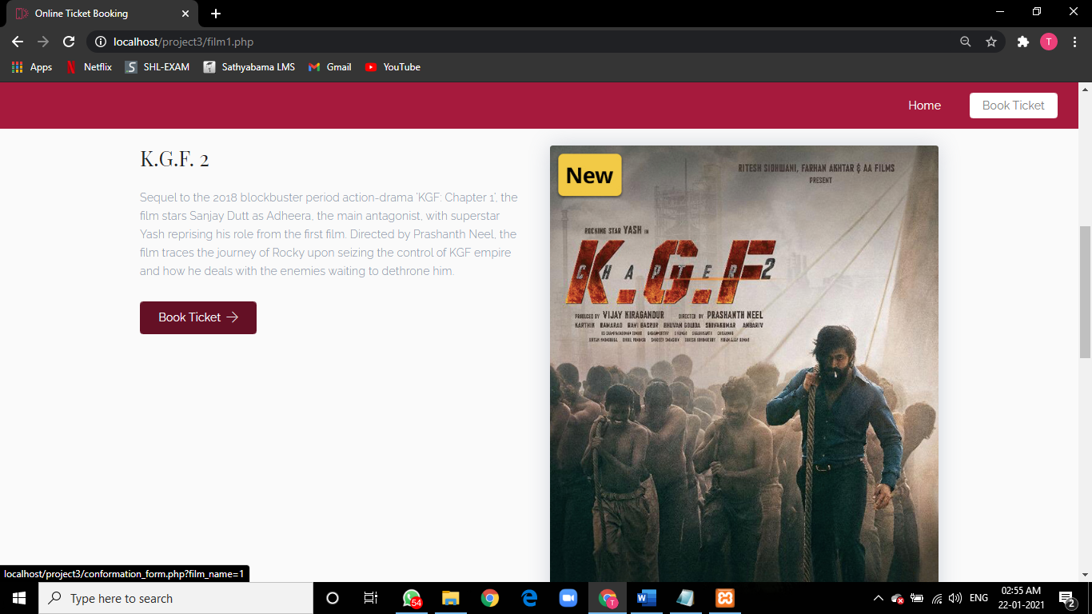
ONLINE- MOVIE TICKET BOOKING PORTAL
FILM1.PHP

Slide 14
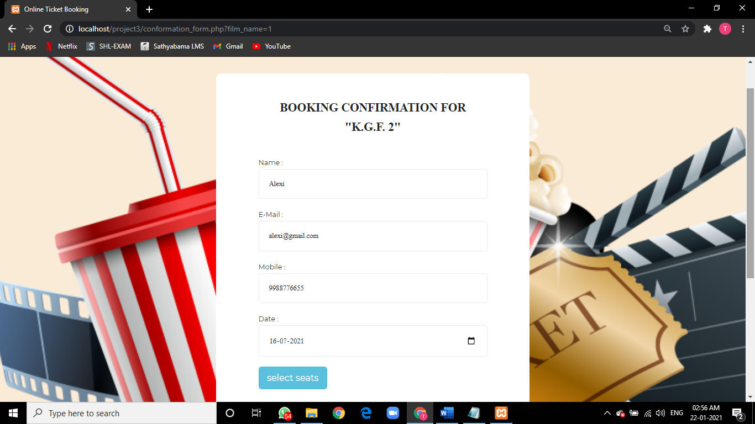
ONLINE- MOVIE TICKET BOOKING PORTAL
Conformation_form.php

Slide 15
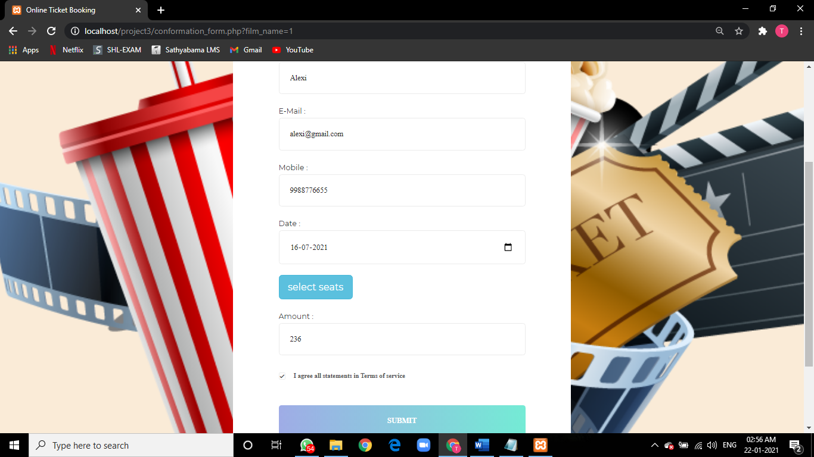
ONLINE- MOVIE TICKET BOOKING PORTAL
Conformation_form.php

Slide 16
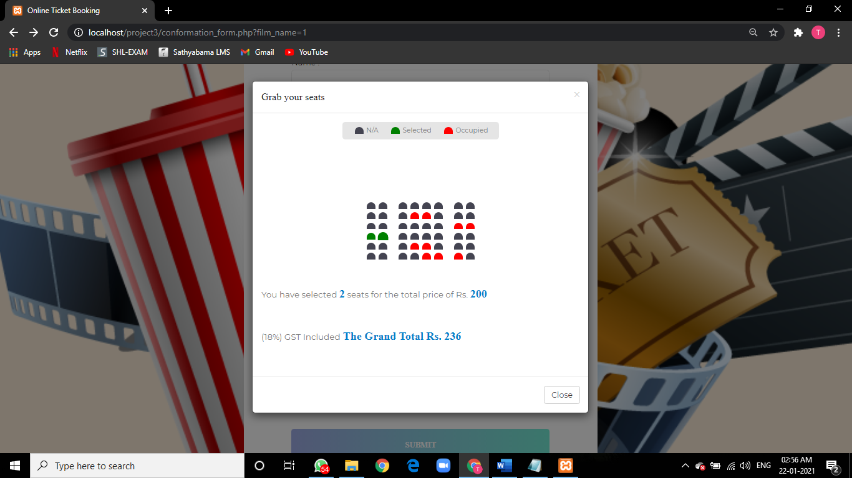
ONLINE- MOVIE TICKET BOOKING PORTAL
Conformation_form.php

Slide 17
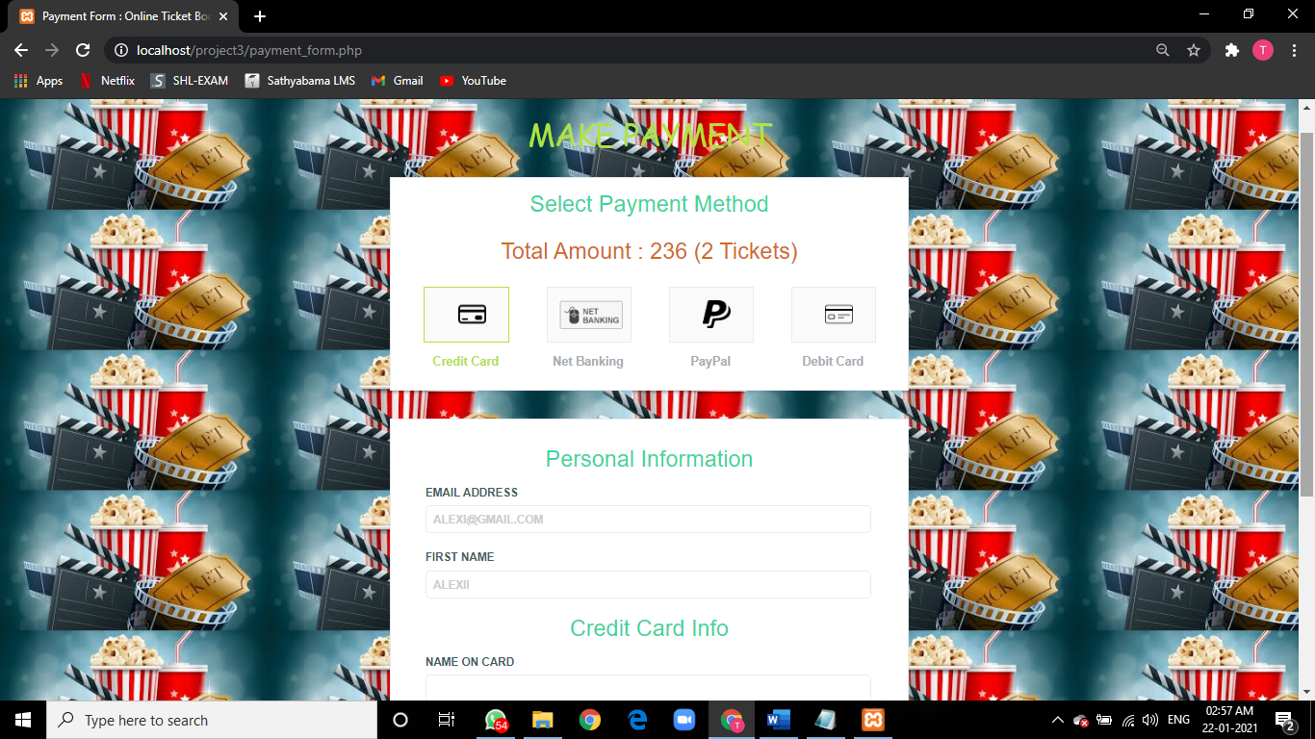
ONLINE- MOVIE TICKET BOOKING PORTAL
Payment_form.php

Slide 18
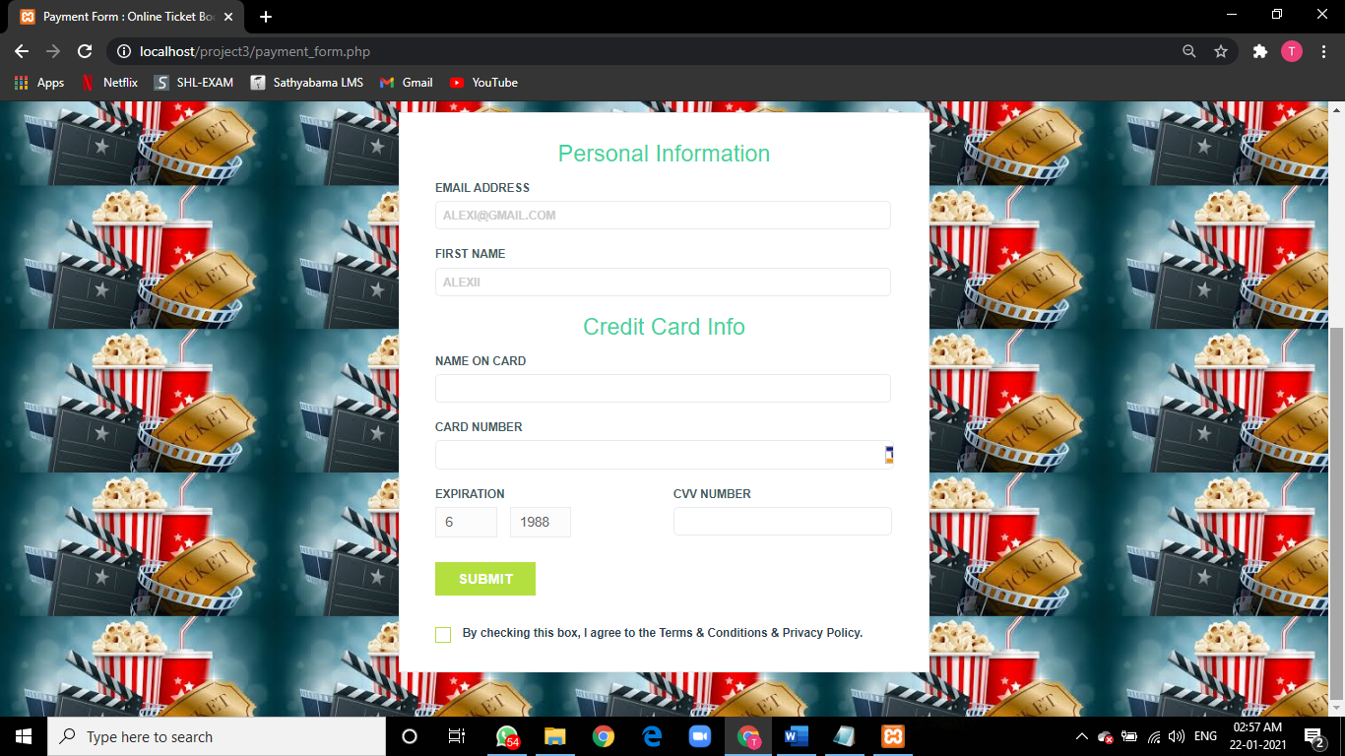
ONLINE- MOVIE TICKET BOOKING PORTAL
Payment_form.php

Slide 19
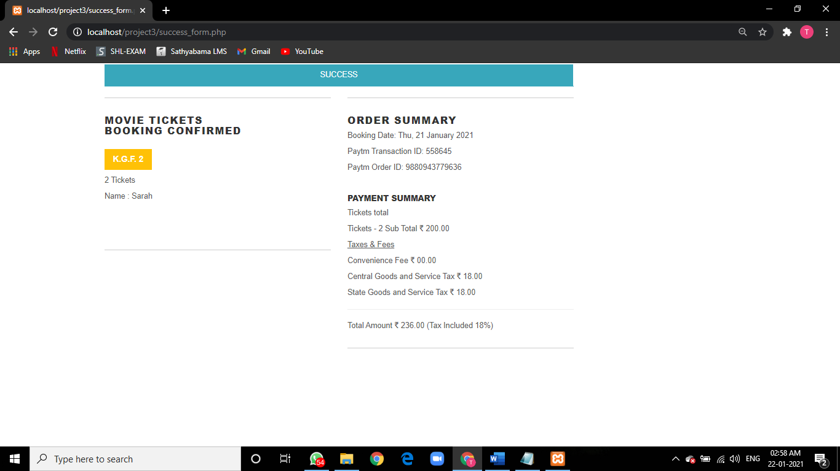
ONLINE- MOVIE TICKET BOOKING PORTAL
Success_form.php

Slide 20
CONCLUSION
The aim of proposed system is to develop a system of improved facilities. The proposed system can overcome all the limitations of the existing system. The system provides proper security and reduces the manual work.
Security of data
Ensure data accuracies.
Proper control of the higher officials.
Minimize manual data entry.
Greater efficiency
Better Service
User friendliness and interactive.
Minimum time required.

Slide 21
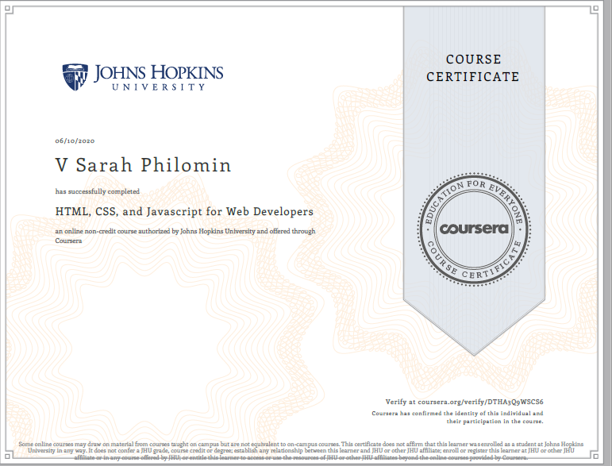
Course certificate

Slide 22
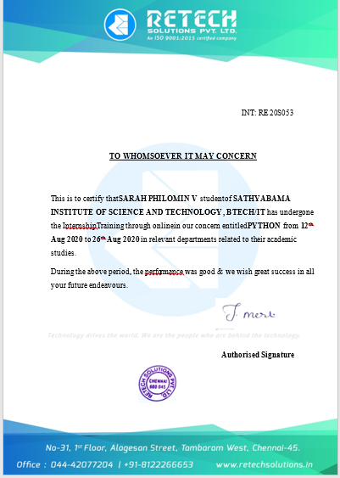
Internship certificate

Slide 23
NAME: V SARAH PHILOMIN
PT1-”ONLINE MOVIE TICKET BOOKING”
INTERNAL GUIDE: E.BRUMANCIA M.E., Ph.D.,
BATCH 2018-2020
SATHYABAMA UNIVERSITY
THANK YOU ☺

